Slide 1

University of Computer Studies, Hpa-An
KIDS’ QUIZ ZONE
Presented by
Group II
Second Year (Computer Science)
Date: 8.10.2024
Supervised by
Daw Poe Ei Phyu

Slide 2
Content
Members List
Abstract
Introduction
Objectives
System Requirement
System Flow Chat
System Implementation
Future Work
Conclusion

Slide 3
Members List
Name | Roll-No | Role
Mg Moe Htet Oo | 2223CS-126 | Leader
Mg Shin Thant Aung | 2223CS-135 | Member
Mg Thar Nge | 2223CS-18 | Member
Mg Kaung Sike | 2223CS-43 | Member
Mg Lin Sat Oo | 2223CS-45 | Member
Mg Kyaw Zin Thet | 2223CS-56 | Member
Mi Kay Thi Khaing | 1920CS-165 | Member
Ma Kyal Sin Win | 2223CS-110 | Member
Ma Thi Thi Nwe | 2223CS-123 | Member
Nan Wine Wine Pyae | 2223CS-95 | Member

Slide 4
Abstract
This quiz website offers an engaging platform for users to test their knowledge across a variety of subjects.
With a user-friendly interface and a diverse range of quizzes, participants can challenge themselves and enhance their learning experience.
The site features real-time feedback, performance tracking, and the option to compete with friends or others worldwide.
Whether for education or entertainment, our quizzes aim to foster curiosity and knowledge retention in a fun, interactive environment.

Slide 5
Introduction
This project is creating a Quiz project system.
We have designed this website with the purpose of allowing the students to give quizzes and view their results.
Students are provided the flexibility to choose among different types of aptitude.
The software is used on the basis of the Questions asked to the user that belongs to the menu topics.

Slide 6
Objective
To enhance learning, we offer fun quizzes that help users explore new subjects.
To develop children's knowledge and thinking skills through educational questions and
a variety of knowledge.
To develop children's skills in math, English, and general knowledge, fostering problem-solving, language proficiency, and a broader understanding of the world.
To promote knowledge retention, we help users remember what they learn through
regular quizzes.

Slide 7
System Requirement
Software Requirement
Any Web Browser
Eclipse, Java
Apache Tomcat Server
MySQL Workbench 8.0 CE
Hardware Requirement
Laptop Core i5-1400H
16.0 GB (RAM)
64-bit Operating System

Slide 8
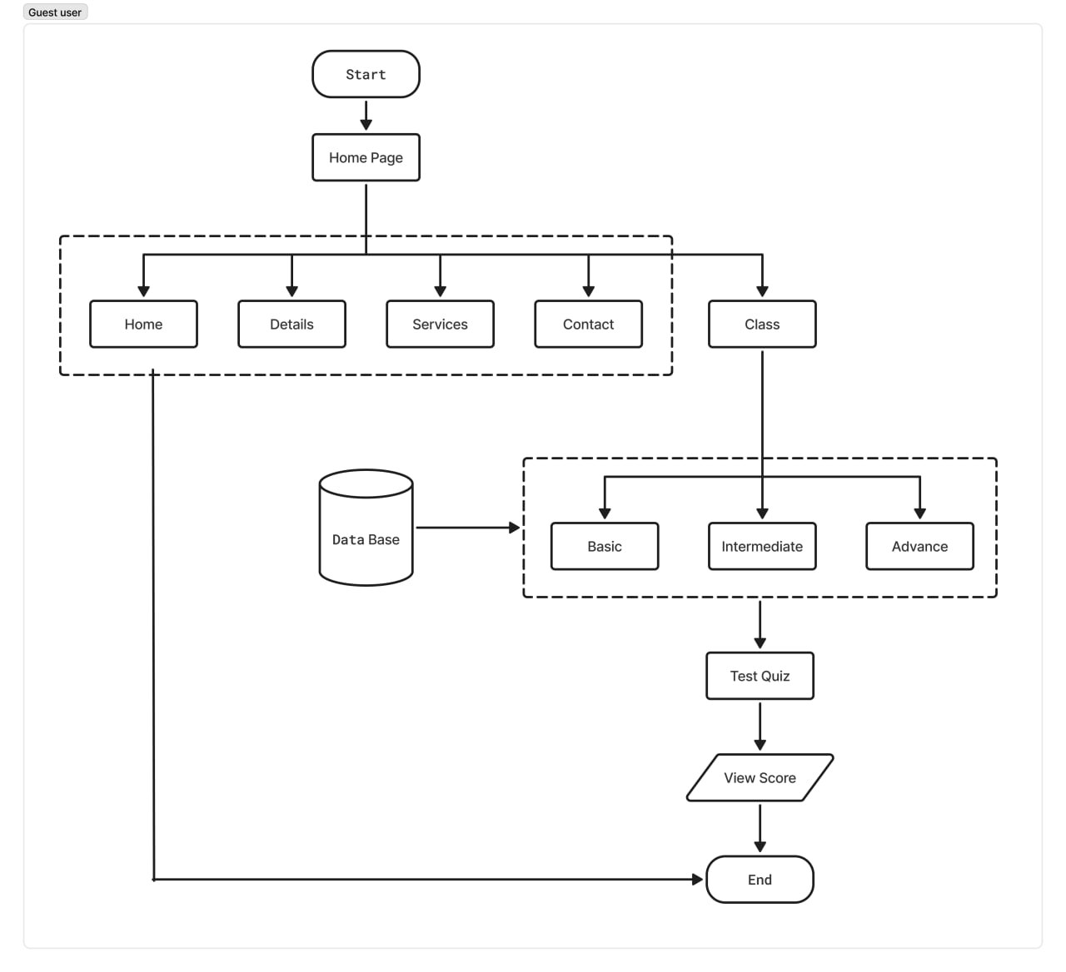
System Flow Chat For Guest

Slide 9
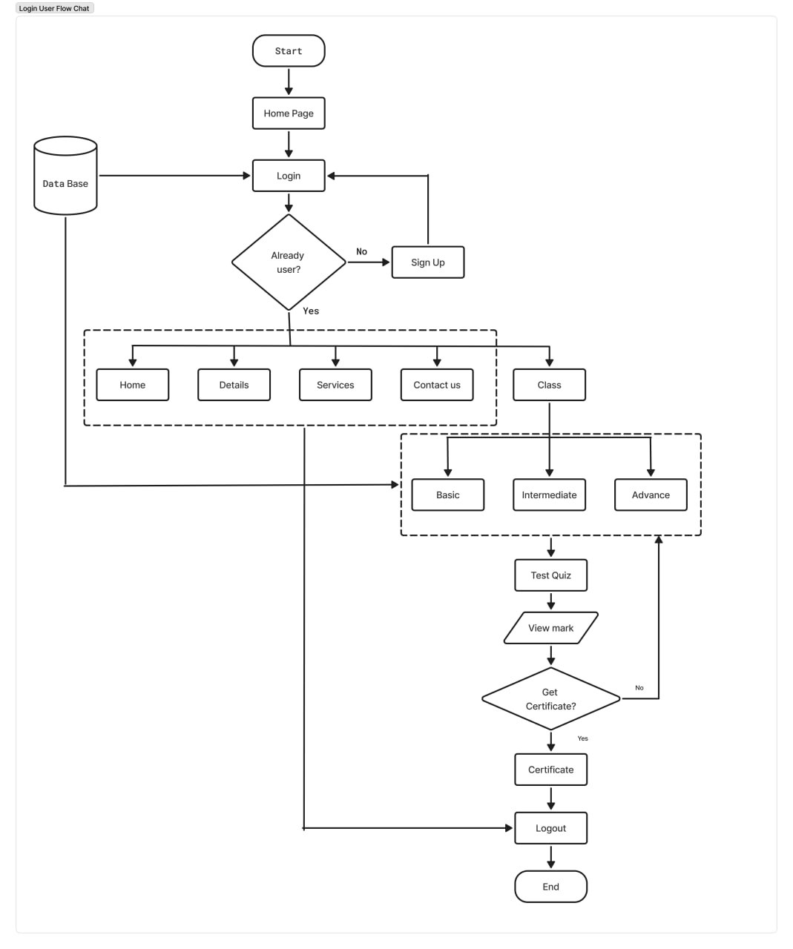
System Flow Chat For User

Slide 10
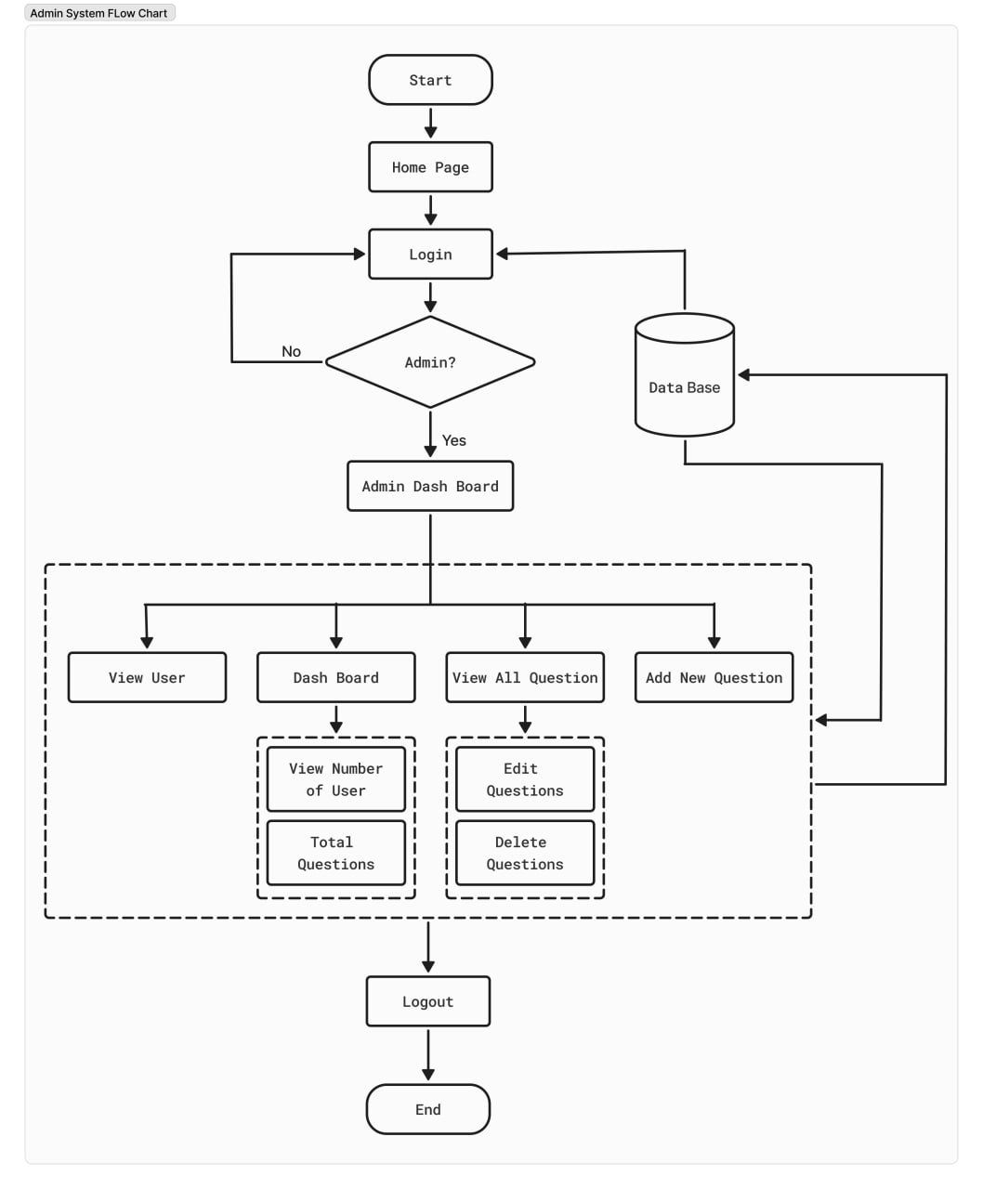
System Flow Chart For Admin

Slide 11
System Implementations For User
Home Page
Signup Page
Login Page
Basic Level
Intermediate Level
Advance Level
Services
Contact Page
Score Page
Certificate Page

Slide 12
System Implementations For Admin
Home Page
Views
Admin Dash Board
Views All User
Views All Question
Questions Edit
Add Questions
Delete Questions

Slide 13
Future Work
We aim to add more quizzes with a wider variety of questions across different subjects and difficulty levels to cater to diverse interests.
Create a safe space for kids to discuss quiz topics or study together.
User-Generated Content: Allow users to create and submit their quizzes.
Introduce seasonal or holiday themes (e.g., Halloween, Christmas) to keep the content lively. Create different themes for specific subjects (e.g., a space theme for science quizzes).

Slide 14
Conclusion
The implementation of the Kids’ Quiz Zone Project has significantly improved the learning experience for children by offering a user-friendly platform for engaging and educational quizzes.
Kids’ Quiz Zone plays a vital role in enhancing children's knowledge and cognitive skills through a wide variety of quizzes tailored to different levels—Basic, Intermediate, and Advanced.
Overall, the Kids’ Quiz Zone Project has been a valuable addition to the educational space, promoting interactive learning, supporting administrators in managing quizzes efficiently, and making the process enjoyable and accessible for young learners.

Slide 15
Thank You For Your Time And Attention!
KIDS’ QUIZ ZONE

